Slide 1
REAL-TIME DATA RESPONSE FOR DYNAMIC OPERATIONS
PRESENTED BY
ROYSTON EMMANUEL- SENIOR TECHNICAL SPECIALIST- EDUCATION
&
KEITH THOMAS- SENIOR TECHNICAL SPECIALIST- DATA & INFORMATION

Slide 2
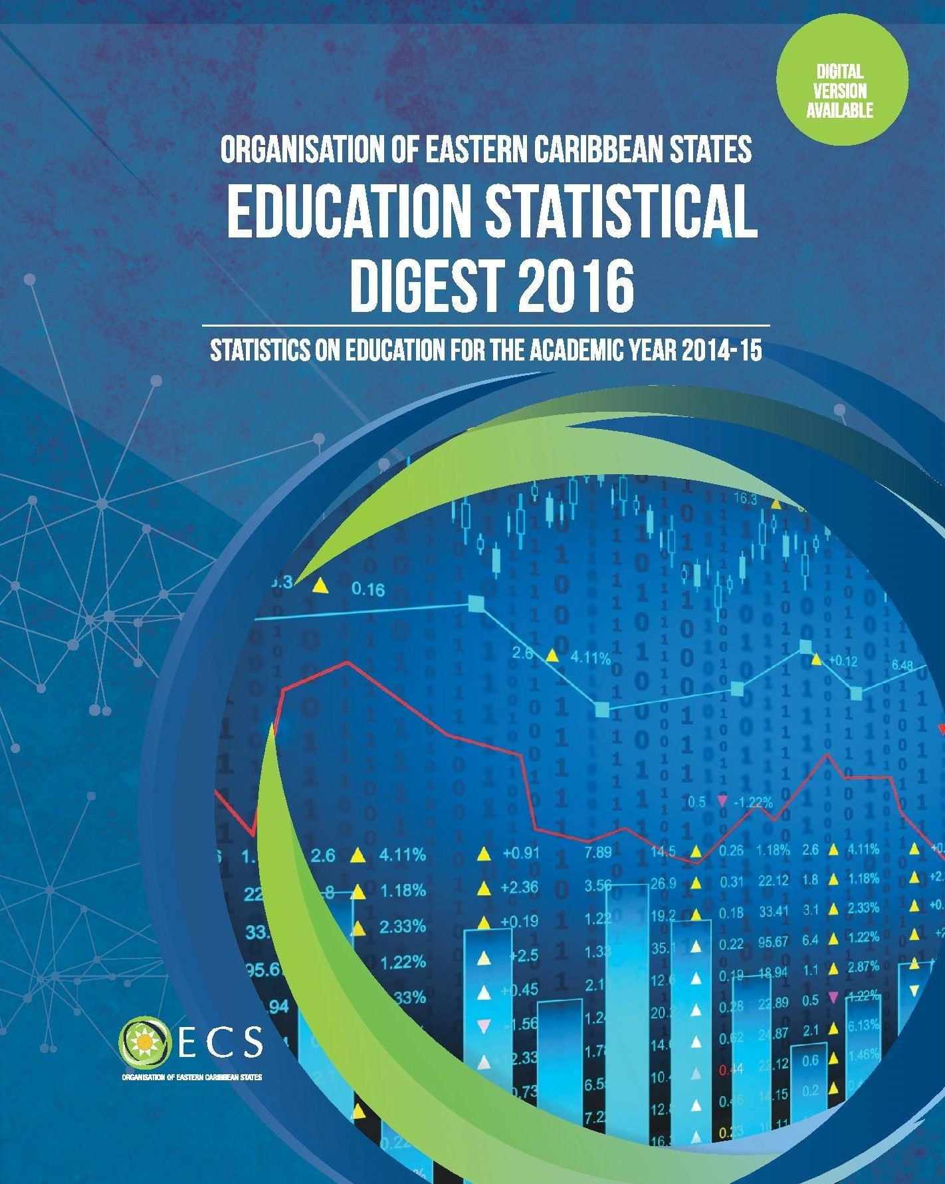



THE CONTEXTUAL FRAMEWORK

Slide 3
THE CONTEXTUAL FRAMEWORK CONT’D
Contributing Member States
Anguilla
British Virgin Islands
Montserrat
St. Kitts & Nevis
Antigua & Barbuda
Dominica
Saint Lucia
St. Vincent & the Grenadines
Grenada
Six Chapters:
Institutions
Leaders & Teachers
Student Enrolment
Internal Efficiency
Systems Output
Education Financing

Slide 4
THE NEED FOR INTER-DEPARTMENTAL COOPERATION & DATA SHARING
Areas for Further Enhancement
How do we support MS in developing intercensal population data?
Implications for calculation of Indicators
Decision-Making
Who is best suited to assist in this area?
Financial Data
Calculation of Indicators
Proportion of the total & by Level
GDP
Summary of Key Indicators

Slide 5
THE NEED FOR INTER-DEPARTMENTAL COOPERATION & DATA SHARING
Areas for Further Enhancement
All MS do not consistently supply data
What are the local trends?
How does this impact regional initiatives?
All Institutions do not report in a timely manner
How can this be improved?
Summary of Key Indicators

Slide 6
DATA ANALYSIS OF SELECTED AREA’S:ENROLMENT
Units of Analysis
OECS Sub Region
Individual Member State
Educational Level
ECE
Primary
Special Education
Secondary
TVET
Post Secondary
Disaggregation by Sex
Questions to Consider
Is there adequate coverage for each cycle? (GER)
Are pupils accessing on-time (Intake Ratios)
Are there differential level of participation by sex ?
Are there noticeable trends across the sub region?
Is it unique to a Member State(s)?
Is it only in a specified area within the MS?

Slide 7
DATA ANALYSIS OF SELECTED AREA’S:INTERNAL EFFICIENCY
Units of Analysis
OECS Sub Region
Individual Member State
Educational Level
ECE
Primary
Special Education
Secondary
TVET
Post Secondary
Disaggregation by Sex
Questions to Consider
What are the levels of:
Repetition
Drop-outs
In which cycle is this most prevalent?
Are the trends different by sex?
Are there noticeable trends across the sub region?
Is it unique to a Member State(s)?
Is it only in a specified area within the MS?

Slide 8
DATA ANALYSIS OF SELECTED AREA’S: STUDENT PERFORMANCE
Units of Analysis
OECS Sub Region
Individual Member State
Educational Level
ECE
Primary
Special Education
Secondary
TVET
Post Secondary
Disaggregation by Sex
Questions to Consider
Are there noticeable trends in student performance across the sub region?
Primary Exit Assessments (Varied)
CSEC
Are there differential levels of performance by sex ?
at what level(s)?

Slide 9
DATA ANALYSIS OF SELECTED AREA’S: EDUCATIONAL FINANCING
Units of Analysis
OECS Sub Region
Individual Member State
Educational Level
ECE
Primary
Special Education
Secondary
TVET
Post Secondary
Disaggregation by Sex
Questions to Consider
Are there noticeable financing trends across the sub region?
What are the allocations like?
Which levels receive greater allocations?

Slide 10
OUR SYNOPSIS
Enrolment
Internal Efficiency
Student Performance
Educational Financing
Are the figures (by level & sex):
Stable
Increasing
Decreasing
Where are the variations?
What are the possible reasons ?
How do we strengthen the gains?
How should we address the areas for further enhancements?

